Slide 1
Post Invasion Companies in Russia
Travis Lindeman

Slide 2
Stakeholder Interest
UPDATE

Slide 3
Agenda
UPDATE
Most popular content creators
Analysis by video category
Most viewed
Most commented
Timeline between publication and trending status

Slide 4
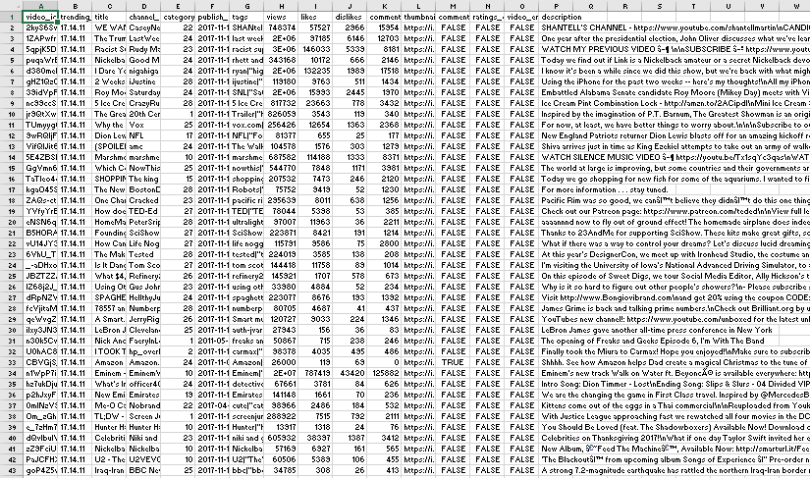
Data of Interest
Channel name
Trending date
Publish time
Views
Comment count
Video Id
Category
UPDATE

Slide 5
Data Cleaning
Duplicate data
Time formatting consistency
Converting time to integers
Date/time formatting
Removing outliers
Visual clarity on category ids
UPDATE

Slide 6
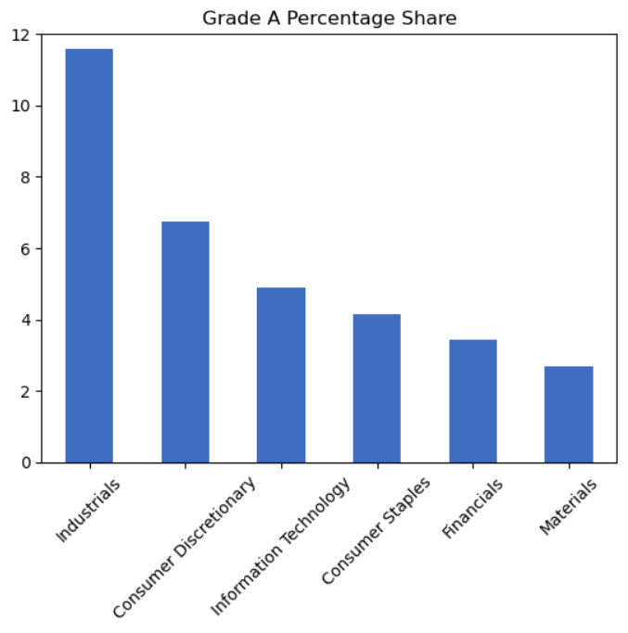
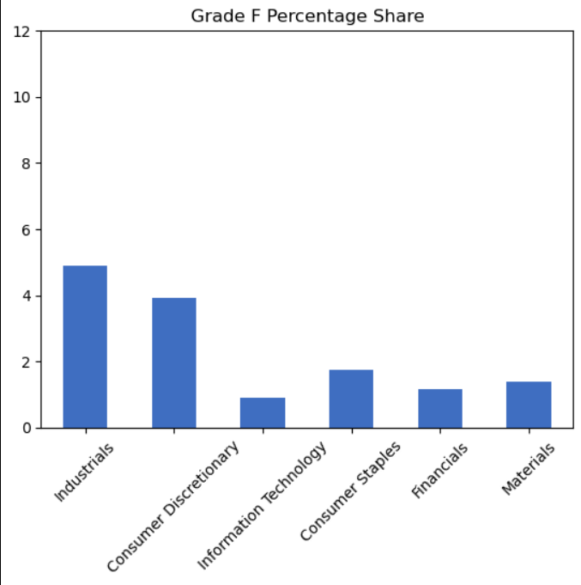
Comparison by Industry: Biggest Six Industries
Industry comparison does not show significant differences

Slide 7
Add a Slide Title - 1

Slide 8
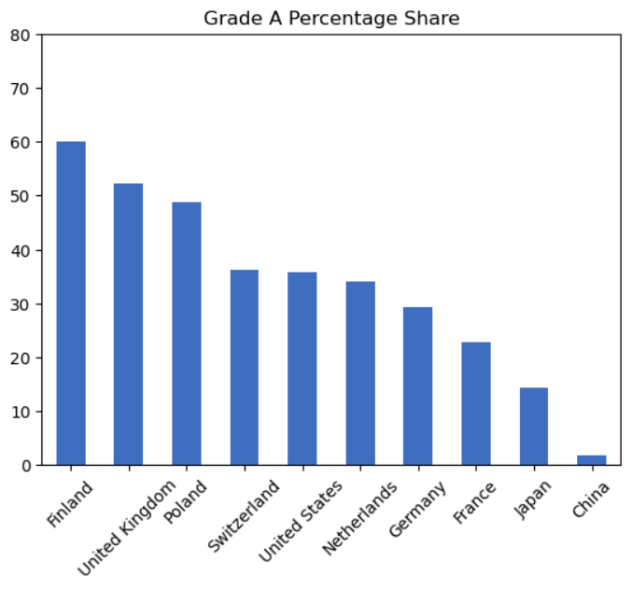
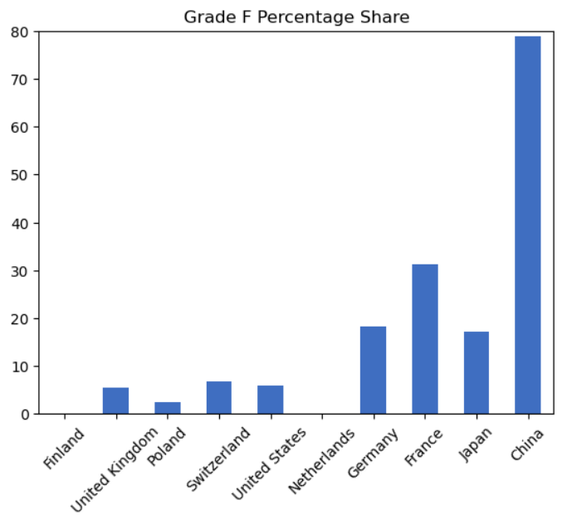
Comparison by Country of Origin: 10 Countries with the Most Companies in Russia
Geopolitical positions correlate with company operations in Russia

Slide 10
Future Project Plans
Trending tags, identifying what makes a video trend
Duration of trending content
Identifying social media platforms in descriptions
UPDATE

Slide 11
Contact Info, Repository & Dataset
Contact Info
Travis Lindeman
travis.lindeman@socom.mil
tralinde@gmail.com
Repository link:
https://github.com/tralinde/companies_in_russia
Dataset link:
https://www.kaggle.com/datasets/vadimtynchenko/list-of-companies-leaving-or-staying-in-russia

